Slide 1
OPTICS Clustering
What is optics clustering:
OPTICS (Ordering Points To Identify the Clustering Structure) is a density-based clustering algorithm similar to DBSCAN clustering. Unlike DBSCAN which struggles with varying densities. OPTICS does not directly assign clusters but instead creates a reachability plot which visually represents clusters. The key concepts in OPTICS are:
Core Distance: The minimum distance needed for a point to be classified as a core point. If a point does not have enough nearby neighbor's, its core distance is undefined.
Reachability Distance: It is a measure of how difficult it is to reach from one point to another. It is calculated as the larger core distance of the starting point and the actual point.
Analogy: Imagine walking through a city:
DBSCAN says: “Here are the neighborhoods, and those people outside are noise.”
OPTICS says: “Let me walk through the city block by block, recording how dense each area is. Later, you can decide where to draw the boundaries depending on how strict you want to be.”
So OPTICS gives you a map of density, not just a single clustering.

Slide 2
When to Use
When clusters have different densities.
When you want to explore hierarchical density structures.
When DBSCAN struggles because a single eps cannot capture all clusters.
Useful in geospatial analysis, anomaly detection, and exploratory clustering.
Step‑by‑Step Process
Start with all points unvisited.
Pick a point and expand its neighborhood.
Record reachability distance for each neighbor.
Continue visiting points in order of increasing reachability distance.
Produce an ordering of points that reflects cluster structure.
Use the reachability plot to decide clusters at different density thresholds.

Slide 3
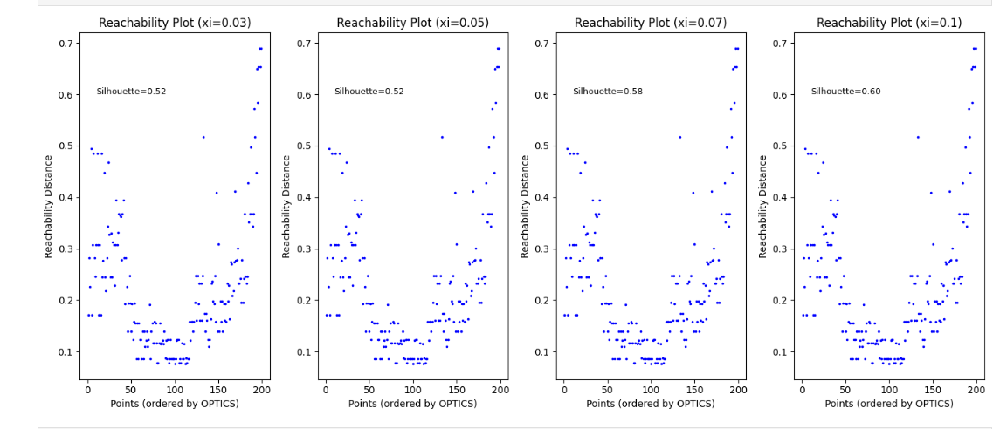
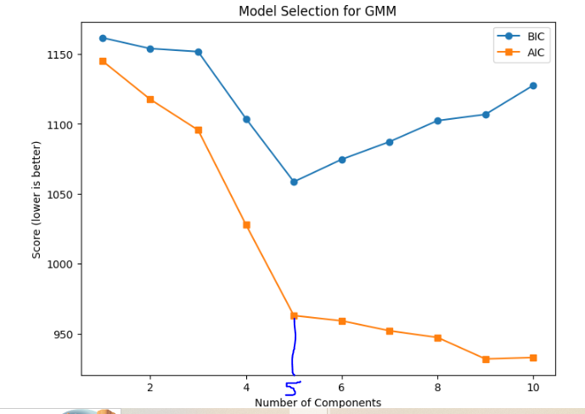
Reachability Plot to decide XI based on Silhouette score

Slide 4
